Slide 1
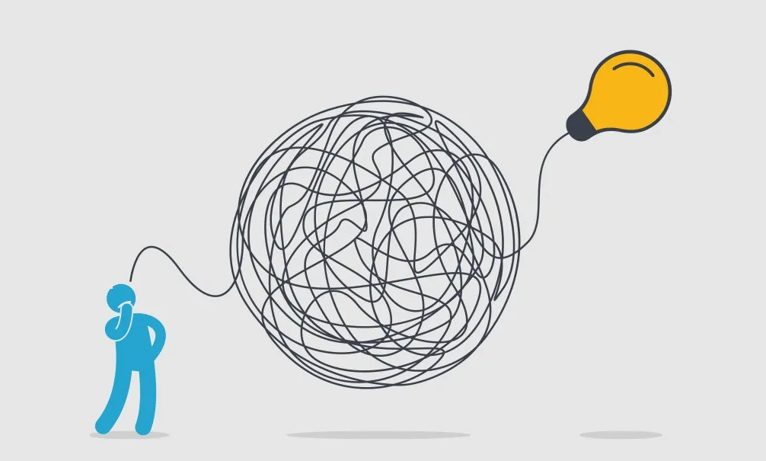
INF20028
Professional Capabilities for a Digital World
Wicked Problems & VUCA Worlds Module
Sense-making Classroom

Slide 2
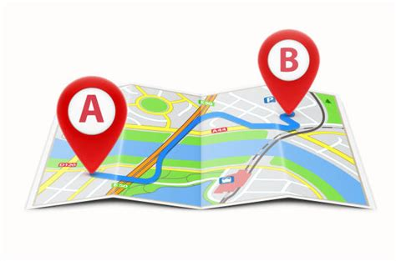


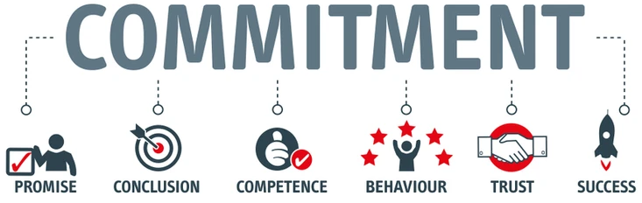
Roadmap for this class
Housekeeping & Roadmap through the semester
Where we left off Group Dynamics
Problems, Wicked problems & Super Wicked Problems
Assignment 2 Extended Bootcamps
Opportunity for Q+A & sense-making on modules and assessments

Slide 3
Housekeeping
Assignment 1 submissions & marking turn around
~Monday 1/5
Marker have <20 mins to download, read, mark/feedback, fill rubric for your paper
Opportunities and experiences not to be missed:
STEM Study Tour to Malaysia (departs in Winter Term) See Canvas announcement for contact details.
ICT20005 ICT for Social Impact India Project (November-December) Contact myself or Stuart.
Both are unit of study and both have $3K NCP scholarships available

Slide 4
1
PROFESSIONALISM & SKILLS FRAMEWORK FOR THE INFORMATION AGE (SFIA)
Let’s Get ethical!
1-2
3--4
1
Data Ethics & Data Governance
Privacy
5
Group Dynamics, Leadership & Communication
2
3
Wicked Problems & The VUCA World
INVESTIGATIVE
CASE STUDY FOUNDATIONS
Professional Belonging:
CoPs & Social Capital
6-7
2
8
2
#UpgradeYourWorld & Public Interest Technology (PIT)
9
MENTAL HEALTH & POSITIVE COMPUTING (NON TEACHING WEEK / NO F2F CLASS)
Weekly Modules
10
Justice, Equity, Diversity & Inclusion (JEDI)
Assignments
11
Professionals Australia / Industry Guest
1
2
3
12
UNIT REVIEW

Slide 5
Where we left off…
Group dynamics is different for each member of the group / that’s why the word ‘dynamics’ is used. There is an inter-play occurring. WE need to be accountable for our contribution into those dynamics.
Be aware of the coloured zones you find yourself in Red & Green Zones. See Jim Tamm’s TED Talk
People often take on distinct roles and behaviours in groups. These roles form part of our self-definition within the group, our sense of who we are.
As professionals, group dynamics are experienced in formalised F2F, virtual and informal locations.
The goal (and challenge) is being a new group but thinking like long-term groups.
Social Loafing and Groupthink
The purple dot. “What do you see?”

Slide 6


Slide 7

This Module
Wicked Problems / VUCA Worlds / Investigative Case Study
UN SDGs \ Systems Thinking \ Design Thinking \ Ideation

Slide 8
VUCA Worlds
Volatility: increasing pace of change
Uncertainty: extent that we can reasonably predict the future
Complexity: the many different and interconnected parts of problems that we face
Ambiguity: not having enough clarity regarding a problem to make an informed decision about it
Simply put, VUCA is a way of saying, "Things are hard to understand and predict at the moment!" and while this sentiment is often true, VUCA can help provide some structure and clarity around the problems that an organisation might face.
One danger of VUCA however, is that people use it as a way of avoiding planning and strategy by focusing on the idea that you can't plan for a VUCA world.

Slide 9
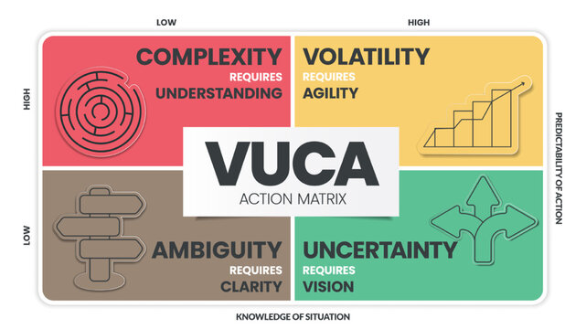
VUCA Action Matrix

Slide 10

VUCA Worlds
Ultimately, VUCA helps us to realise that old ways of working cannot be relied upon
Success in a VUCA World =
being agile + having the ability to adapt to the changing winds.
Our journey is not always going to be linear and there has become a real need to live in the moment and change when needed.

Slide 11


Slide 12


Solve/Manage This!
Breakout Room Activity

Slide 13
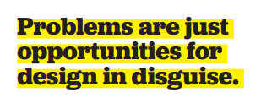
Shallow Dive
You are the logistics lead
You need to get a 4WD vehicle to the other side of a swollen river
What is your solution to the problem?
Discuss in small groups for 5 minutes.

Slide 14
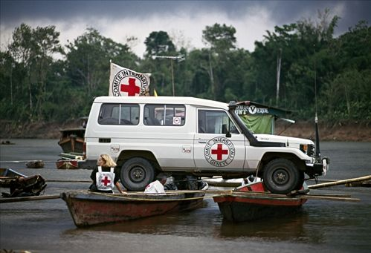

Slide 15
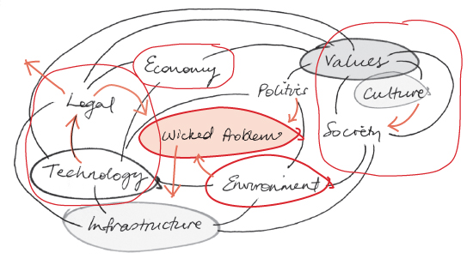
Wicked Problems

Slide 16

Wicked Problems
Most social problems—such as inequality, political instability, death, disease, or famine—are wicked
Horst Rittell & Melvin Webber (1973)
Rittell’s Characteristics of Wicked Problems
No definitive formulation
It's hard, maybe impossible, to measure or claim success with wicked problems
Solutions can be only good or bad, not true or false
No wicked problem ‘template’ to follow
Always more than one explanation

Slide 17
Wicked Problems
Rittell’s Characteristics of Wicked Problems (Cont.)
Every wicked problem is a symptom of another problem
No definitive scientific test for any mitigation strategy
A solution can be seen as a one shot which changes the design space (the problem) for the next
All wicked problems are unique
Designers attempting to address a wicked problem must be fully responsible for their actions
Tame problems can be clearly stated, have a well-defined goal, and stay solved.
Wicked problems have complex cause-and-effect relationships, human interaction, and inherently incomplete information. They require compromises.

Slide 18
Wicked Problems / How to address them
There are generally 3 common strategies or approaches to addressing (complex) Wicked problems
authoritative strategies - where an authority decides and imposes a solution.
competitive strategies - where different stakeholders compete to deliver a solution.
collaborative strategies - where different stakeholders work together to develop and implement solutions.
Which one works best & why?
Wicked Problems / Require more than a transactional response

Slide 19


Wicked Problem Taming
While wicked problems may be unsolvable but…
Problems with wicked dimensions can sometimes be rendered tame.
In the 1950s and early 60s sending a manned spacecraft to the moon with live passengers and bringing them back to earth in good health may have been a wicked problem.
If it wasn’t wicked, it came close, and it involved many wicked dimensions – scientific, political and economic”.

Slide 20
The loaded term ‘solution’
The term “solutionism” usually in the form of “technocratic solutionism” has been used since the 1960s to mean the belief that every problem can be fixed with technology.
This is wrong, and so “solutionism” has been a term of derision.
But if we discard any assumptions about the form that solutions must take, we can reclaim it to mean simply the belief that problems are real, but solvable.
Are you a ‘Solutionist’?
Solutionists may seem like optimists because solutionism is fundamentally positive. It advocates vigorously advancing against problems, neither retreating nor surrendering.
Jason Crawford, MIT Technology Review 13/7/2021
Notes:
https://www.technologyreview.com/2021/07/13/1028295/proud-solutionist-history-technology-industry/?utm_medium=tr_social&utm_campaign=site_visitor.unpaid.engagement&utm_source=LinkedIn

Slide 21

Challenging Characteristics of ‘Systems’ Systems are LARGE, COMPLEX, AND REAL-WORLD They are the domain in which technology is applied
YOU (will) work in INDUSTRY on/in such SYSTEMS
Notes:
<a href="https://www.freepik.com/free-photo/happy-surprised-man-smiling-pointing-finger-left-touching-head-amazed-cant-believe-his-luck-found-something-interesting-standing-white-wall_19051021.htm#query=surprise%20man&position=28&from_view=keyword&track=ais">Image by cookie_studio</a> on Freepik

Slide 22
Ways of looking at systems

Slide 23
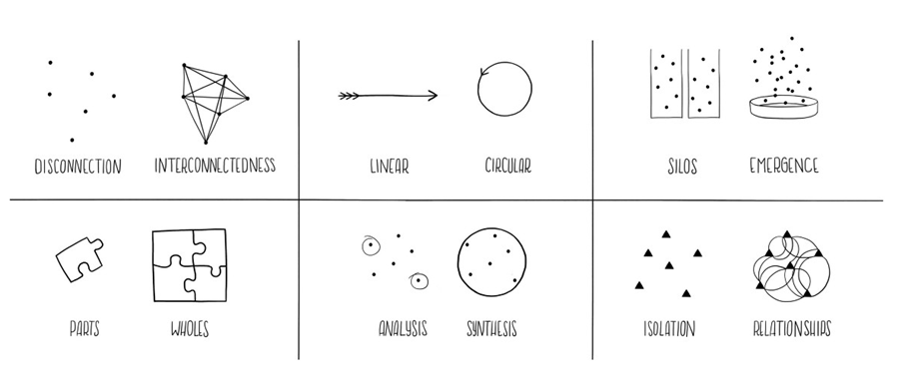
Tools of systems thinkers

Slide 24
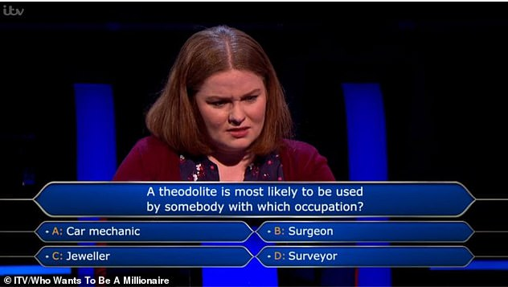
Can you name a systems thinking guru?
A well known & respected system thinker is?
A: Donella Meadows
B: Donald Trump
A: Donella Meadows
C: Kim Kardashian
D: Virat Kohli

Slide 25
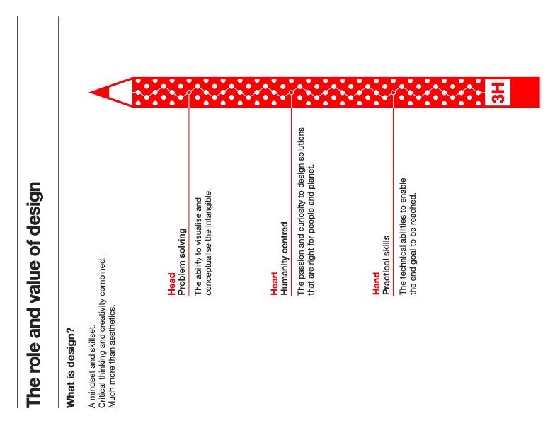
Design Thinking
Design Thinking is a Mindset
What’s a ‘mindset’?
Design thinking is about believing we can make a difference, and having an intentional process in order to get to new, relevant solutions that create positive impact.
Design Thinking gives you faith in your creative abilities and a process for transforming difficult challenges into opportunities for design.

Slide 26
Design Thinking
Design thinking often consists of five commonly used steps:
Empathize / about the people (customers, users, students, stakeholders) you are co-designing a solution with/for
Define / Defining + understanding/comprehending the problem
Ideate / Generating ideas and brainstorming around the problem
Prototype / Conceptualising rough prototypes of your idea/s
Test / Validating, getting feedback from others

Slide 27


Slide 28
Systems Thinking
Drawing instructions to make toast.
Breakout Room Activity

Slide 29
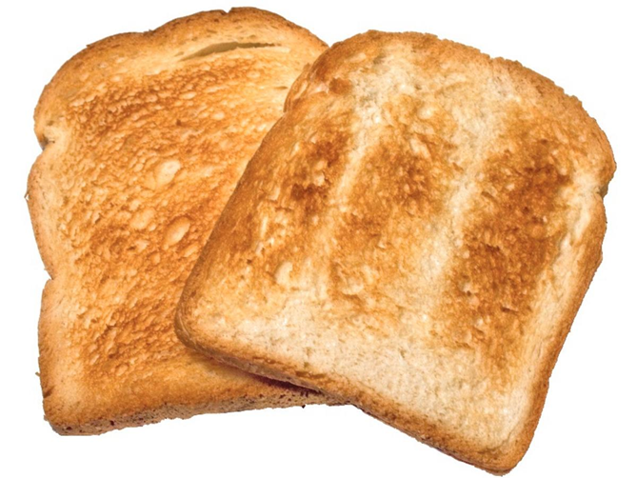
How to make toast
Move into your Assignment 2 Groups
Draw instructions on how to make toast. DRAW, not write!
You have 5 mins
You can talk amongst yourselves, but you CANNOT ask for further guidance
Show/take image and/or post it

Slide 30
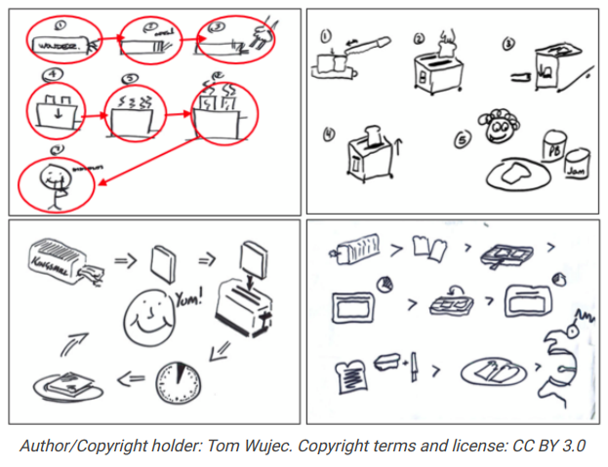

Slide 31
How to make toast
Name the system components involved in making toast
Can the instructions be followed by ALL stakeholders?
What needs to be improved for Ver 2.0?
What group dynamics occurred in the co-design of the process of creating the instructions?
Is there a better comfort food than a Toastie? (Non-assessable)

Slide 33
Why Wicked Problems & VUCA Worlds in INF20028?
People and technology working together to build a better world.
Our renewed vision is the essence of our tech identity. For us, technology is not an end in and of itself. Instead, it is technology’s capacity to enable social, environmental, economic and cultural good that is intrinsically valuable.
We will develop our learner’s Professional Purpose to build employability skills and capabilities. This aligns a learner’s professional future to their personal values, societal outlook and aspirations.
ACS: Technologists use discretion in identifying and resolving complex problems and demonstrates an analytical and systematic approach to problem solving.

Slide 34

Week 6 Action Items: Your check list to be completed
Self-pace through the weekly content as it becomes available (published). Go back to any you may have missed.
Drop by t the Watercooler Conversations and have your say
Engage with your Assignment 2 group
Reflect on what’s working & what’s not.
Next week Assignment 2 considerations around CoPs, Social Capital and the Socio-Technical co-design approach.

Slide 35


Virtual Coffees occur Wednesday evenings 7-7:45pm
Optional, & informal drop-ins for online consultations.
Drop by a minute, 10 or as long as it takes (within limits)
No need to book and the sessions are not recorded.
Check the Collaborate Ultra link for the session.

Slide 36



Slide 37

Assessment 2 Bootcamp

Slide 38


Slide 39
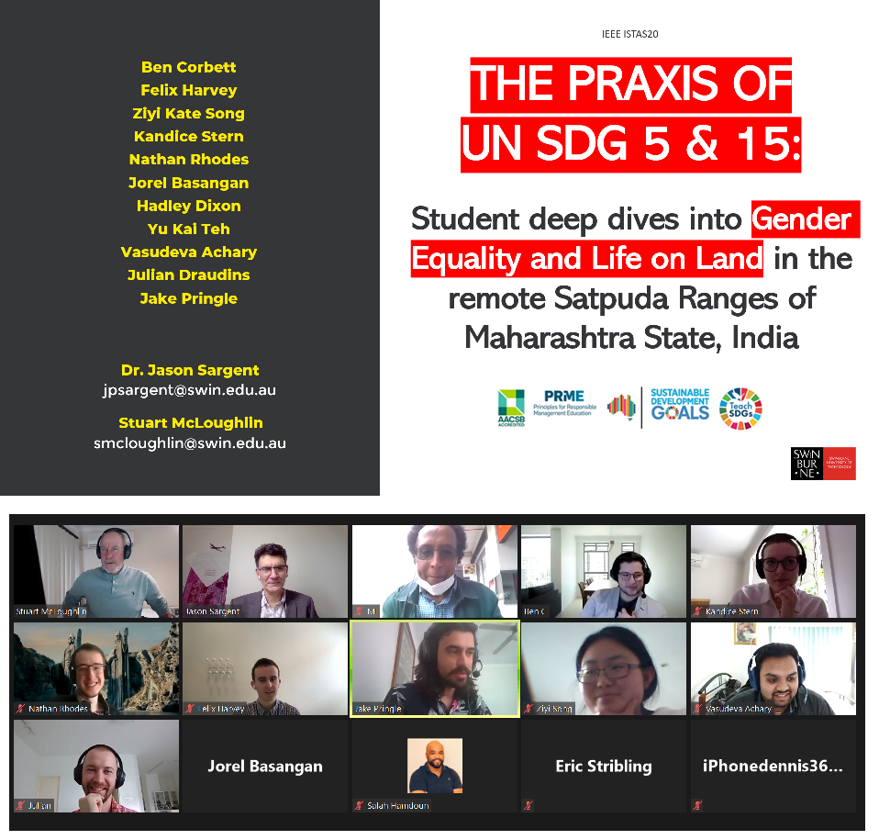
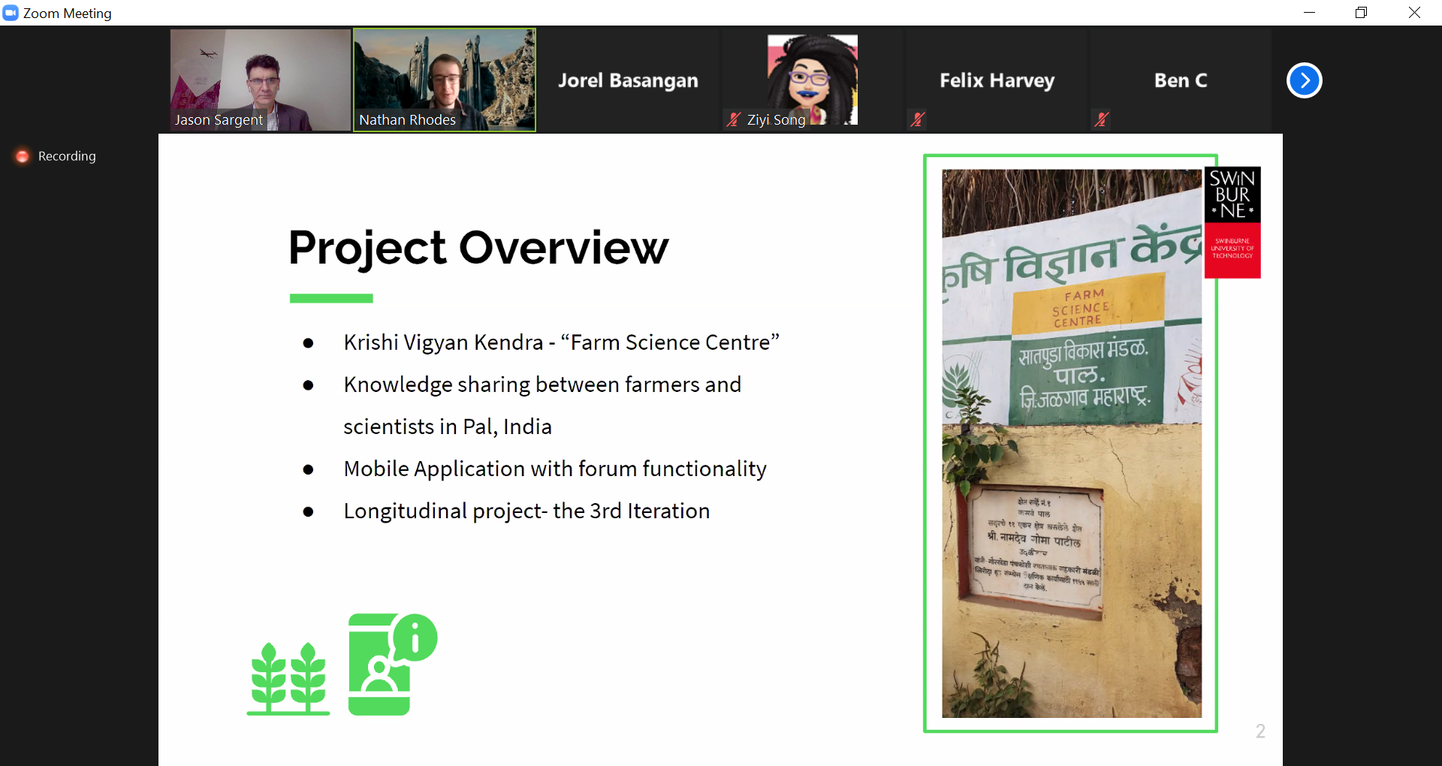
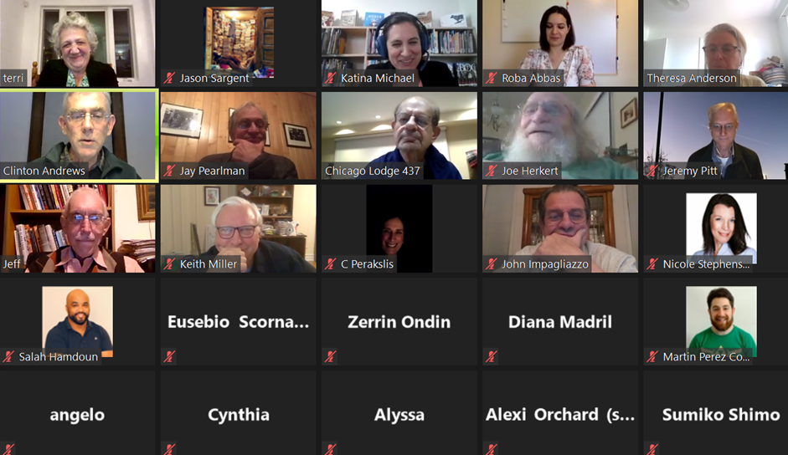

Slide 40
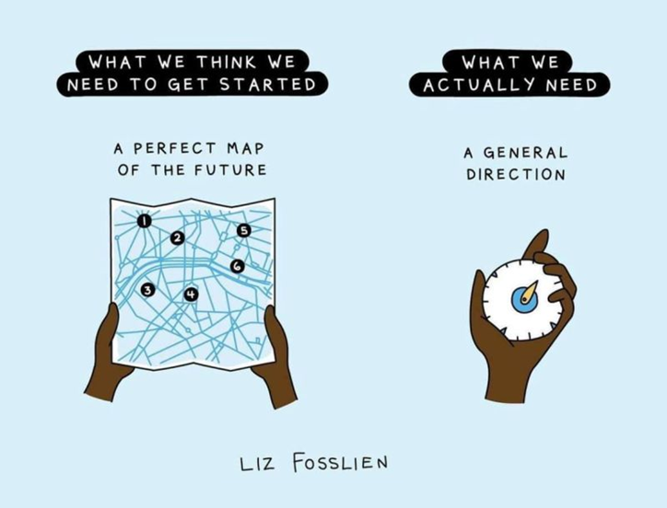
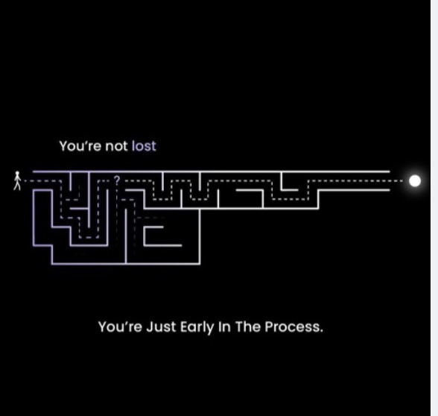

Slide 41
Let’s reverse engineer your Assignment 2 reqs…
The group must build a recorded presentation (video)
The presentation must include contributions by all group members
Who does what parts in the presentation is up to the group
The presentation must describe how the group suggests to address 1 wicked problem of 1 UN SDG. The description will include a technology (or technologies) deployed with a socio-technical co-design approach.
The choice of Wicked Problem, SDG and Technology is entirely up to the group.
The group must submit a transcript of the presentation. This is the text of what is spoken by everyone during the presentation.
The group can submit the video file into Canvas or a Word doc into Canvas that contains a link to the recording in a cloud location. If the recording can be viewed it can be marked.

Slide 42
Let’s reverse engineer your Assignment 2 reqs…
You will present with camera on.
You will not be the focus of the presentation. Your video will be a small box in the corner of the marker’s scree.
The slides therefore should not be text/dot point heavy and the text read by the presenter. The slides should be image heavy and impactful and relevant to the topic and context. (Example: No Sth American village images in your African village proposed solution).

Slide 43
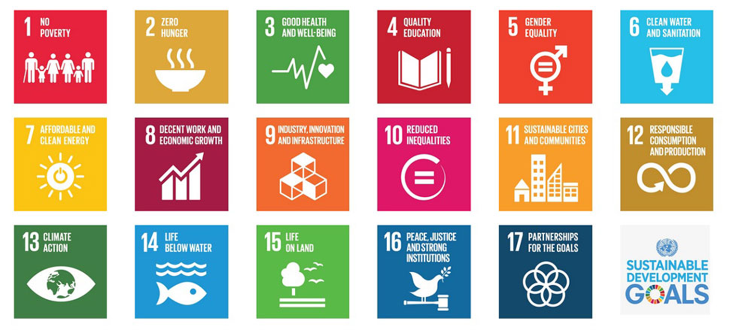
The UN SDGs
Which ones are Wicked? Which ones are not.

Slide 44
Go Broad to Go Narrow
Breakout Room Activity

Slide 45


DEEP DIVE: Go Broad to Go Narrow
After selecting an SGD, think of as many Wicked Problems related to that Goal as possible. There are no good or bad suggestions.

Slide 46
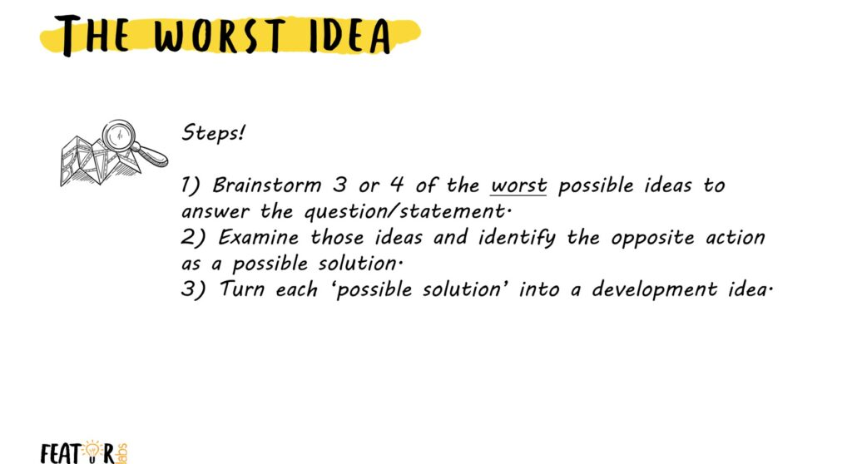
Assessment 2 Bootcamp

Slide 47
What tools/assets do we have?
Group collective knowledge/expertise/passion
The UN SDGs. Go straight to the source.
Google, Google Scholar, Google Images
Theories & Frameworks: The name of those dudes who gave the phenomena ‘Wicked problems’ the name: Rittell & Webber
A brief recording on socio-technical co-design by Roba Abbas (University of Wollongong)
Examples of previous student submitted solutions

Slide 48
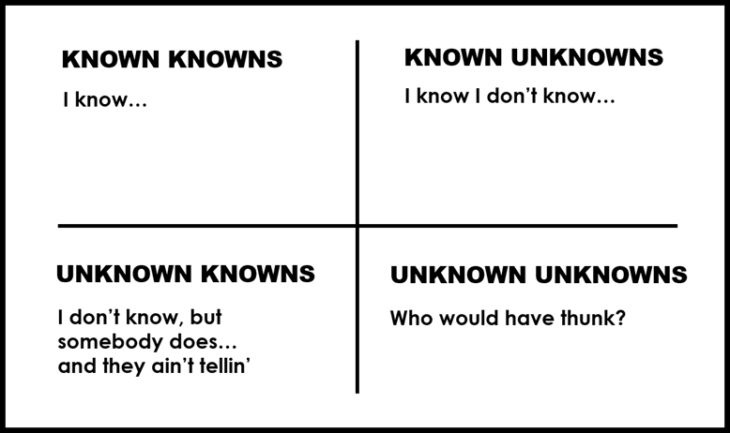


Again, what do we (the group) know?
Known Knowns, Known Unknowns, Unknown Knowns & Unknown Unknowns
Donald Rumsfeld on the reason for invading Iraq

Slide 49
Define the Challenge
Frame the problem
Rewrite the problem statements into “how might we” questions in order to frame the problem as a possibility.
Keep it simple.
Describe your challenge simply and optimistically.
Make it broad enough to allow you to discover areas of unexpected value, and narrow enough to make the topic manageable.
Sketch out end goals
Define your goals for undertaking this design challenge. Be honest about determining a realistic scope of your project both regarding time and output.
What will you work to produce?
Where do you expect to get at the end of this process?

Slide 50
Define the Challenge /2
Define measures of success
What else are you working toward?
What will make this work successful?
What are the measures of success? Most of the time, these measures of success emerge as you dig into your project, but it helps to start to think about this at the onset.
Establish constraints
It is crucial to define constraints and get specific on the problem or question you are trying to address.
Does it need to fit into a certain timeframe? Can it be integrated with an existing structure or initiative? Make a list of the constraints you need to manage.

Slide 51
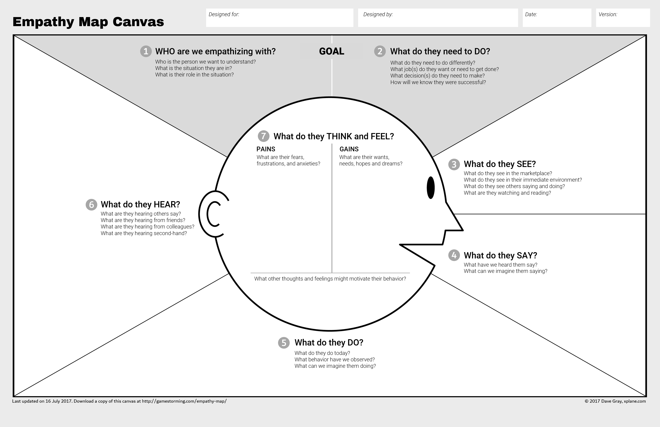
Consider using this as a tool to understand your Assignment 2 proposed solution
Notes:
An Empathy Map consists of four quadrants. The four quadrants reflect four key traits, which the user demonstrated/possessed during the observation/research stage. The four quadrants refer to what the user: Said, Did, Thought, and Felt. It’s fairly easy to determine what the user said and did. However, determining what they thought and felt should be based on careful observations and analysis as to how they behaved and responded to certain activities, suggestions, conversations, etc.

Slide 52
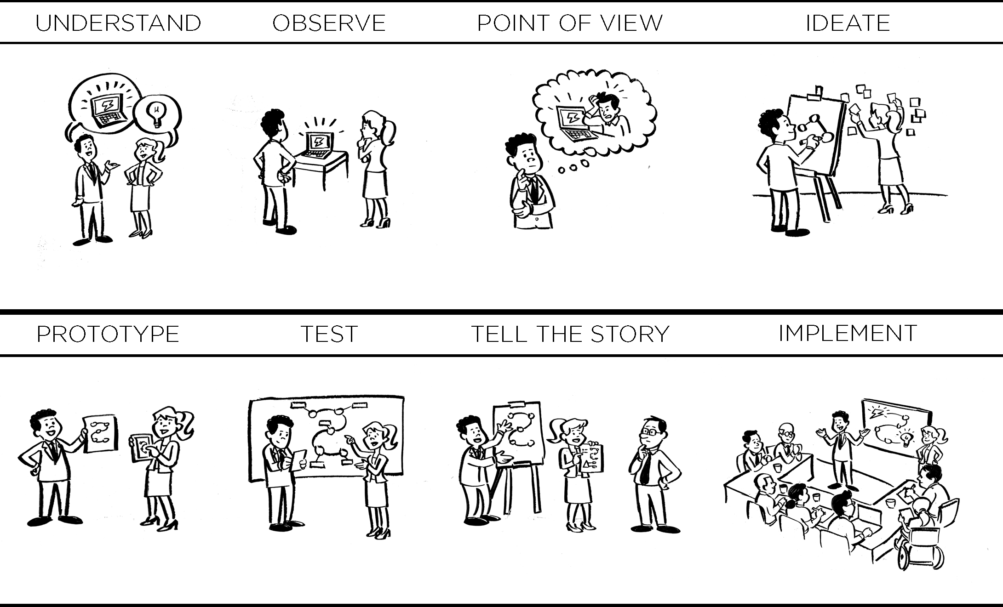
Which steps in Design Thinking will your group do?

Slide 53
Intended & unintended consequences
Everything has both intended and unintended consequences. The intended consequences may or may not happen; the unintended consequences always do — Dee Hock, President of VISA
In the 1954 short story “Answer,” Fredric Brown envisions many great scientists working for years to build a giant computer network, connecting the computing power of billions of planets. As the inaugural question for this technological marvel, the gathered dignitaries ask, “Is there a God?”
The computer doesn’t hesitate before answering, “There is now!”

Slide 54


Slide 55


Please Sir, may I have some more?
Notes:
These extra/supplementary slides are non-assessable.

Slide 56
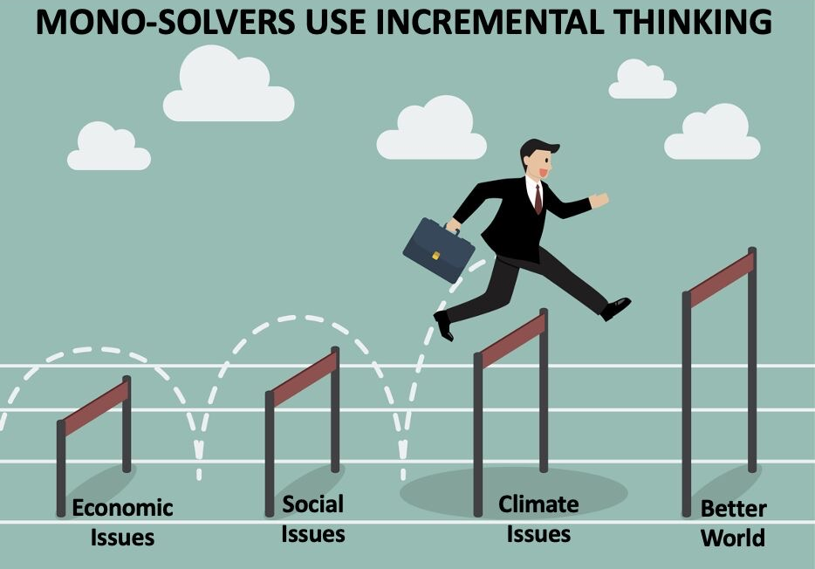

Slide 57
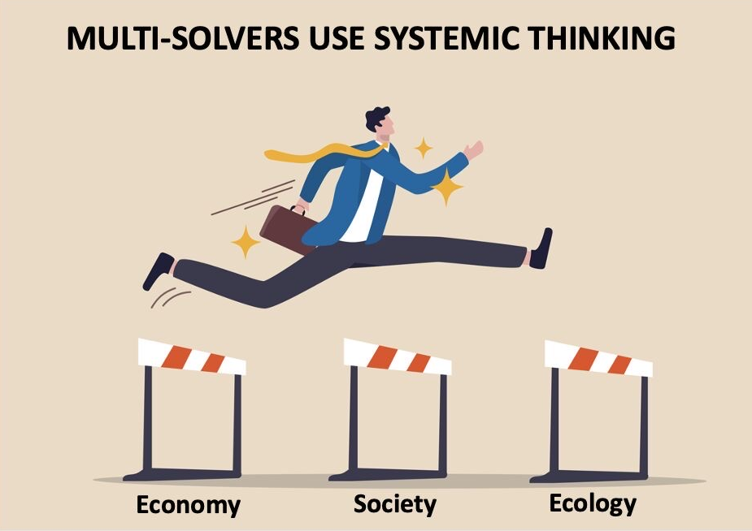

Slide 58

Wicked Problems/ Self-Assessment.
Gauge your current ability to:
Develop an openness to perspectives from other disciplines AND be able to trust these
Recognise the many different interacting elements within wicked problems
Grasping the local and situated nature of wicked problems as well as seeing the broader global contexts for them
Accept uncertainty about the impact of any efforts to solve wicked problems
Coming to terms with the lack of black and white explanations or answers
Not just acknowledging the lack of easy answers but also involved coming to terms with this emotionally: ‘that you have to think about these issues deeply about complexity and how you feel about these challenges.

Slide 59
Wicked Problems/ Self-Assessment (2).
Gauge your current ability to:
Work with imperfect framings of problems or a mix of different theoretical perspectives.
Work across countries and cultures; with policymakers; with business; with NGOs.
Consider the perspectives of those most affected by wicked problems and respecting their knowledge.
Realise that your preferred solution to a wicked problem might not work in a particular figured world given the diverse perspectives in play.
Have an open mind to the fact that things happen differently in [the world of business in] different places for different reasons.

Slide 60
Wicked Problems/ Self-Assessment (3).
Gauge your current ability to:
Demonstrate ambition and confidence, but also humility and the capacity to admit being unsure.
Being open about what you do not know or your own uncertainty about the best approaches to wicked problems.
Understand how you are complicit in the creation or continuation of wicked problems.

Slide 61
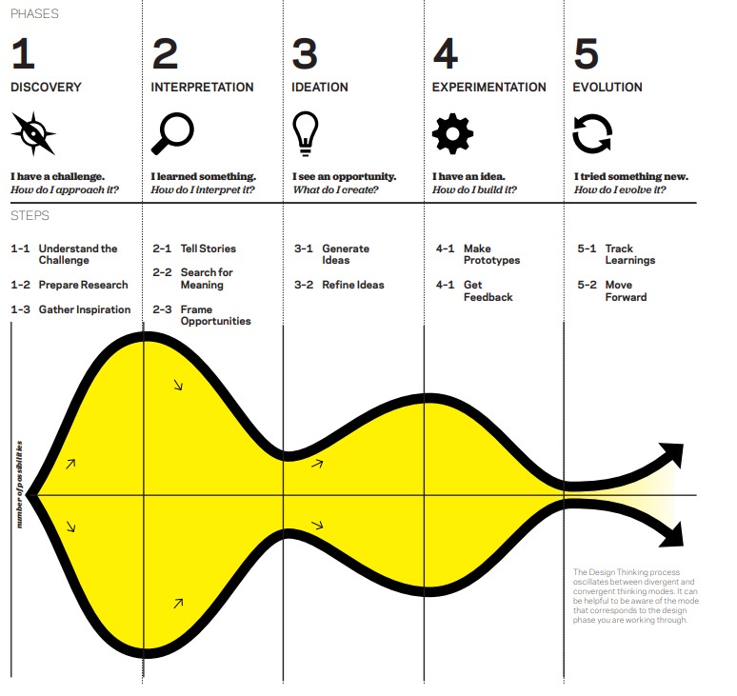
Design Process

Slide 62
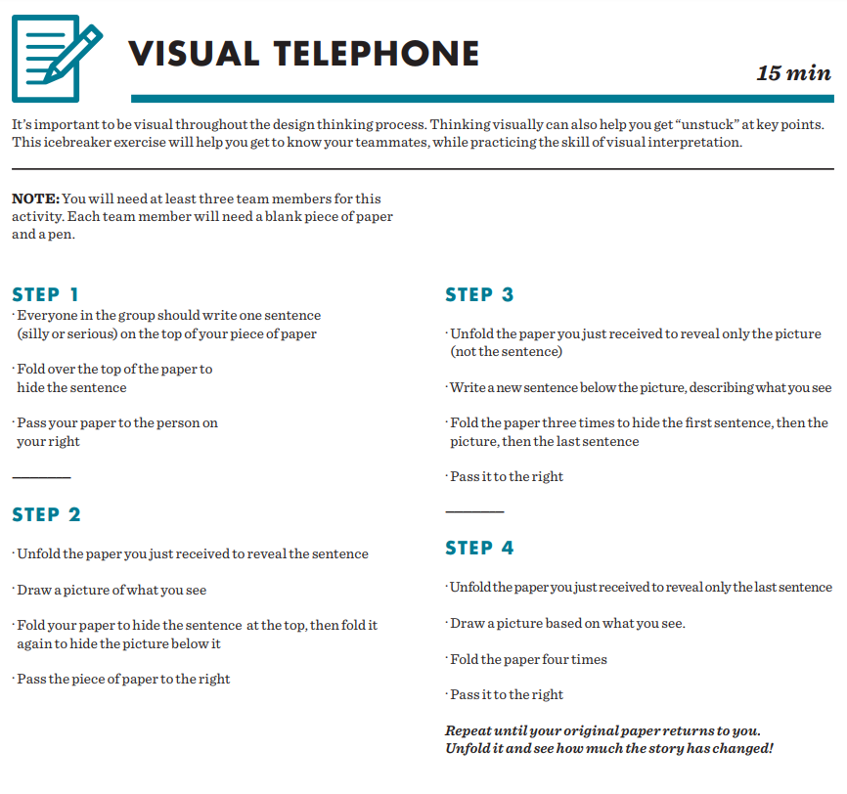

Slide 63
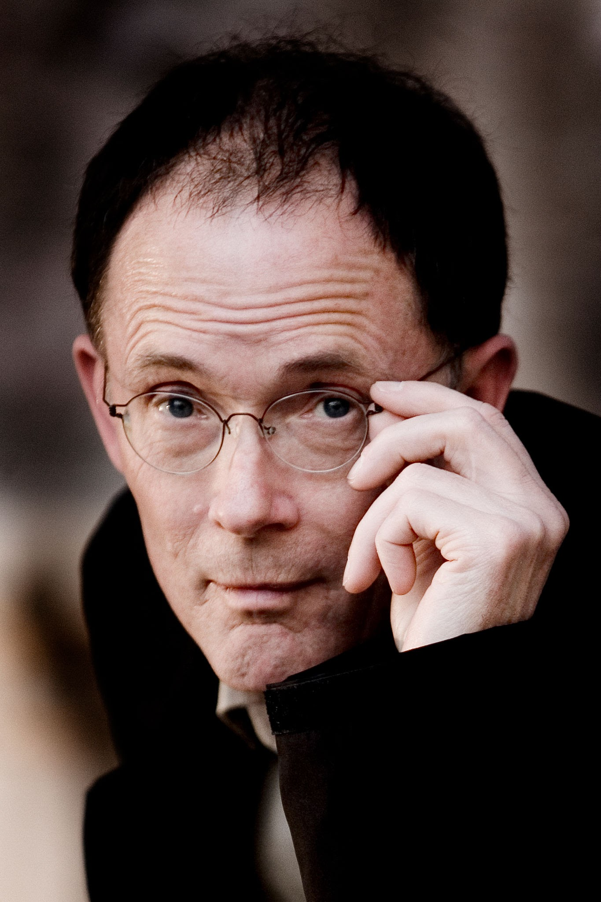


“The future is here. It’s just not evenly distributed”
Click on the image of Gibson and/or see notes for this slide…

Slide 64

Takeaways from the first half of the module/semester.
Framework Thinking
Critical Thinking
Thinking means concentrating on one thing long enough to develop an idea about it. Not learning other people’s ideas, or memorising a body of information, however much those may sometimes be useful.
The best way to improve your ability to think is to spend time _ _ _ _ _ _ _ _ .
Growth mindsets = professionalism
Professionals are not saints. They are fallible human beings who can have ‘off days’
Extend your knowledge without being reminded to
A disciplined approach is required to improving your level of professionalism

Slide 65
Inverted VUCA: A glass half-full perspective
Bob Johansen, who brought the VUCA concept into the business area in 2009, three years later came up with the inverted VUCA model, which describes possible responses to the VUCA reality. Inverted VUCA proposes to apply:
VISION - as a response to volatility
UNDERSTANDING - as a response to uncertainty
CLARITY - as a response to complexity
AGILITY - as a response to ambiguity
Key factors for incorporating the values into organisational culture are:
Transparency, Trust, Debate, and Collaboration.

